Slide 1



NodeJS Web Server
Serving HTTP requests
End-to-end JavaScript Applications
Telerik Software Academy
http://academy.telerik.com

Slide 2

Table of Contents
The HTTP Protocol
What is a Web Server
Create basic server with NodeJS
The Request stream object
The Response stream object
Route requests
Using NodeJS as client

Slide 3


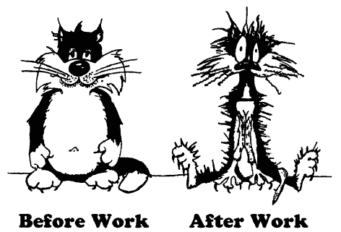
The HTTP Protocol
How HTTP Works?
HTTP

Slide 4
HTTP
Hyper Text Transfer Protocol (HTTP)
Client-server protocol for transferring Web resources (HTML files, images, styles, etc.)
Important properties of HTTP
Request-response model
Text-based format
Relies on unique resource URLs
Provides resource metadata (e.g. encoding)
Stateless (cookies can overcome this)

Slide 5
HTTP: Request-Response Protocol
Client program
Running on end host
E.g. Web browser
Requests a resource
Server program
Running at the server
E.g. Web server
Provides resources
GET /index.html
HTTP/1.0
HTTP/1.0 200 OK
"Welcome to our
Web site!"
5

Slide 6
Example: Hyper Text Transfer Protocol
HTTP request:
GET /academy/about.aspx HTTP/1.1
Host: www.telerik.com
User-Agent: Mozilla/5.0
<CRLF>
The empty line denotes the end of the request header
HTTP response:
HTTP/1.1 200 OK
Date: Mon, 5 Jul 2010 13:09:03 GMT
Server: Microsoft-HTTPAPI/2.0
Last-Modified: Mon, 12 Jul 2010 15:33:23 GMT
Content-Length: 54
<CRLF>
<html><title>Hello</title>
Welcome to our site</html>
The empty line denotes the end of the response header

Slide 7
HTTP Response Codes
HTTP response code classes
1xx: informational (e.g., “100 Continue”)
2xx: success (e.g., “200 OK”)
3xx: redirection (e.g., “304 Not Modified”, "302 Found")
4xx: client error (e.g., “404 Not Found”)
5xx: server error (e.g., “503 Service Unavailable”)
"302 Found" is used for redirecting the Web browser to another URL

Slide 8
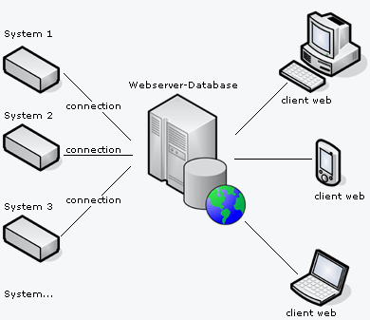
What is a Web Server

Slide 9
What Do the Web Servers Do?
All physical servers have hardware
The hardware is controlled by the operating system
Web servers are software products that use the operating system to handle web requests
Web servers serve Web content
These requests are redirected to other software products (ASP.NET, PHP, etc.), depending on the web server settings

Slide 10
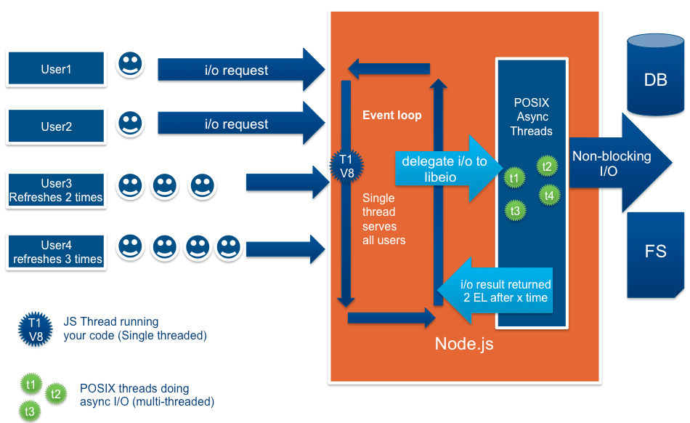
NodeJS Web Server

Slide 11
NodeJS Web Server
Require the 'http' module
Create server function (createServer)
Request/Response wrapper objects
Listen function (specifies port and IP (host))
Headers are objects (keys are lowercased)
{ 'content-length': '123',
'content-type': 'text/plain',
'connection': 'keep-alive',
'accept': '*/*' }

Slide 12
NodeJS Web Server
Basic server implementation
http://nodejs.org/api/http.html
var http = require('http');
http.createServer(function(req, res) {
res.writeHead(200, {
'Content-Type': 'text/plain'
}); //return success header
res.write('My server is running! ^_^'); //response
res.end(); //finish processing current request
}).listen(1234);

Slide 13
NodeJS Basic Web Server
Live Demo

Slide 14

The Request Wrapper

Slide 15
The Request Wrapper
The Request wrapper
http.IncommingMessage class [docs]
Implements the Readable Stream interface
Properties
httpVersion – '1.1' or '1.0'
headers – object for request headers
method – 'GET', 'POST', etc
url – the URL of the request

Slide 16
The Request Wrapper
Live Demo

Slide 17

The Response Wrapper

Slide 18
The Response Wrapper
The Response wrapper
http.ServerResponse class [docs]
Implements the Writable Stream interface
Methods
writeHead(statusCode, [headers])
var body = 'hello world';
response.writeHead(200, {
'Content-Length': body.length, // not always valid
'Content-Type': 'text/plain',
'Set-Cookie': ['type=ninja', 'language=javascript']
});

Slide 19
The Response Wrapper
Methods
write(chunk, [encoding])
end()
Always call the methods in the following way
writeHead
write
end
response.writeHead('Hello world!'); // default encoding: utf8

Slide 20
The Response Wrapper
Live Demo

Slide 21

Route Requests

Slide 22
Route Requests
URL Parsing modules
'url' and 'querystring'
both have parse method
var url = require('url');
console.log(url.parse('/status?name=ryan', true));
// logs
// {
// href: '/status?name=ryan',
// search: '?name=ryan',
// query: { name: 'ryan' },
// pathname: '/status'
// }

Slide 23
Route Requests
Live Demo

Slide 24
NodeJS as Client

Slide 25
NodeJS As Client
http.request and http.get
both have (options, callback) signature
var req = http.request(options, function(res) {
console.log('STATUS: ' + res.statusCode);
console.log('HEADERS: ' + JSON.stringify(res.headers));
res.setEncoding('utf8');
res.on('data', function (chunk) {
console.log('BODY: ' + chunk);
});
});
http.get("http://www.google.com/index.html", function(res) {
console.log("Got response: " + res.statusCode);
})

Slide 26
Resources
http://nodejs.org/ - NodeJS official web site
http://nodejs.org/api/ - API documentation
http://blog.nodejitsu.com/npm-cheatsheet - NPM documentation
https://npmjs.org/ - NPM official web site
https://github.com/felixge/node-style-guide - NodeJS style guide

Slide 27
NodeJS Web Server
http://academy.telerik.com

Slide 28
Exercises
Create file upload web site with NodeJS. You should have the option to upload a file and be given an unique URL for its download. Use GUID.
You are not allowed to use ExpressJS

